Slide 1

Enable RedSky from Control Hub

Slide 2
Set Up Emergency Call Settings
To get started, click Set up emergency call settings from the Control Hub Overview screen

Slide 3
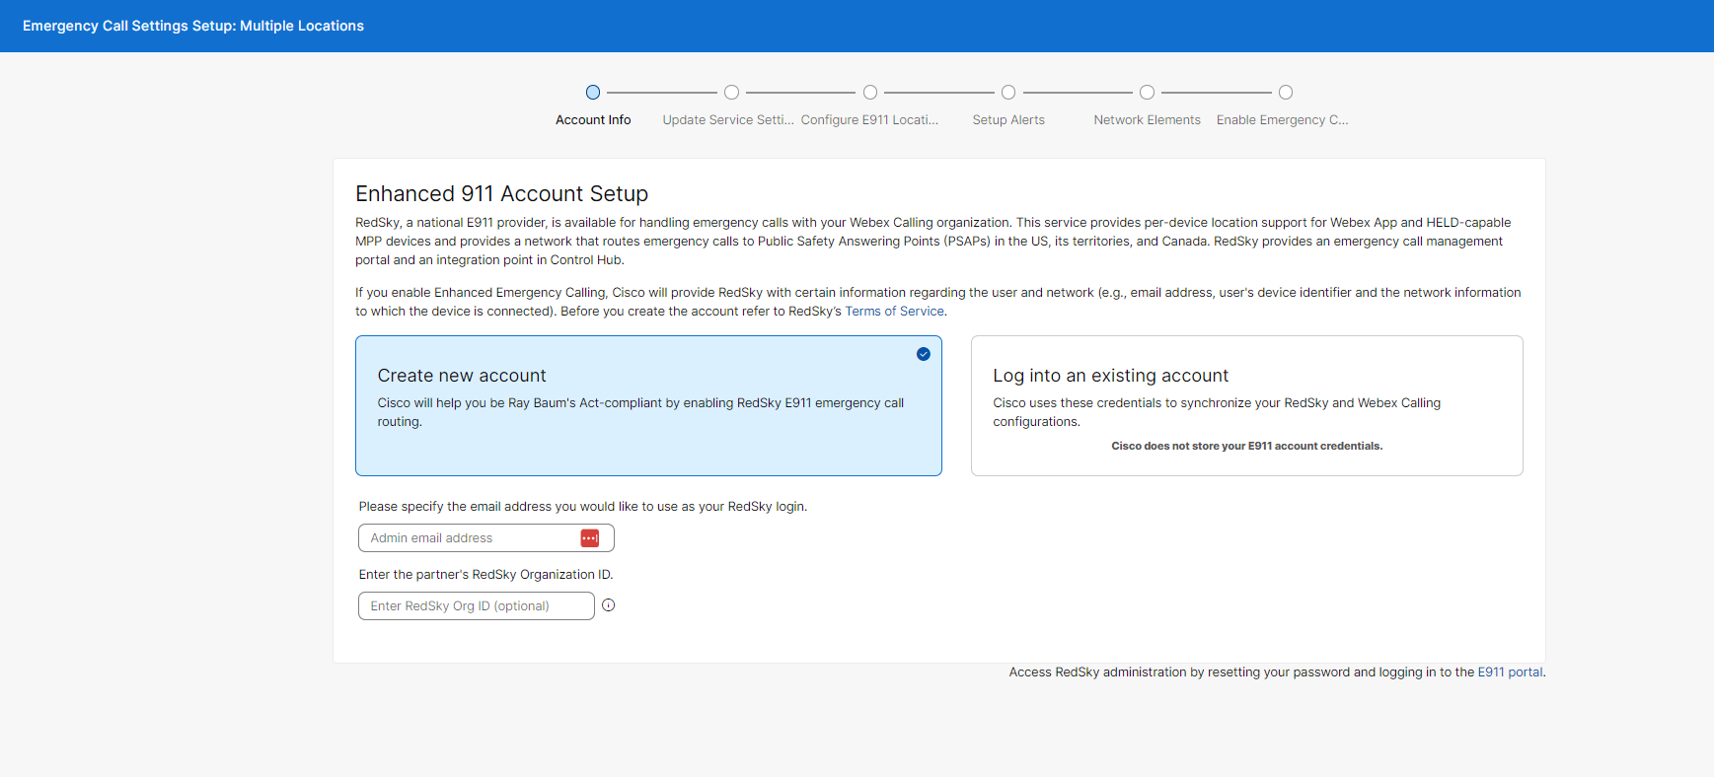
RedSky Account Setup - Specify Admin and Partner’s Org ID
Select Create new account. This will create an Org in RedSky Horizon Mobility, under the Partner tenant, and create an Admin account

Slide 4
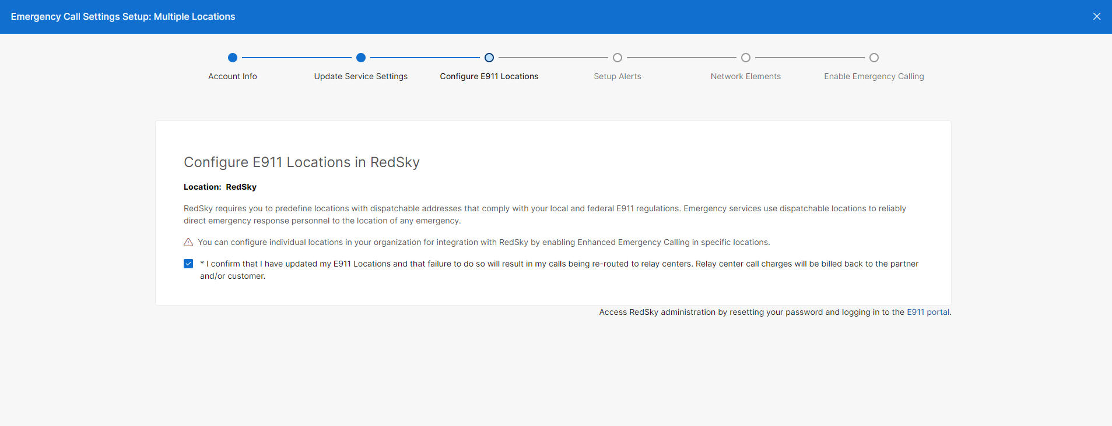
Configure E911 Locations
Click the link to access the Horizon Mobility portal.

Slide 5
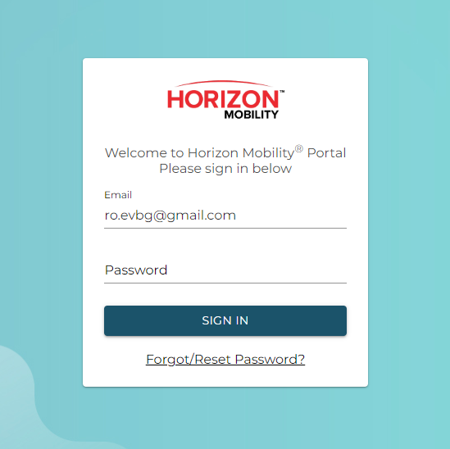
Reset Password
The first time you access Horizon Mobility you will need to set your password. Click the Forgot/Reset Password link. Use the email you provided for the account creation.

Slide 6
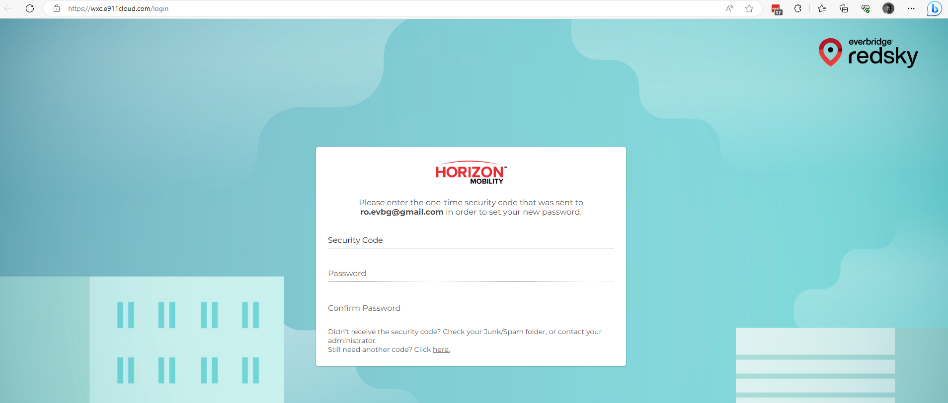
Verification Code
You will be emailed a verification code. Enter the code and a new password.

Slide 7
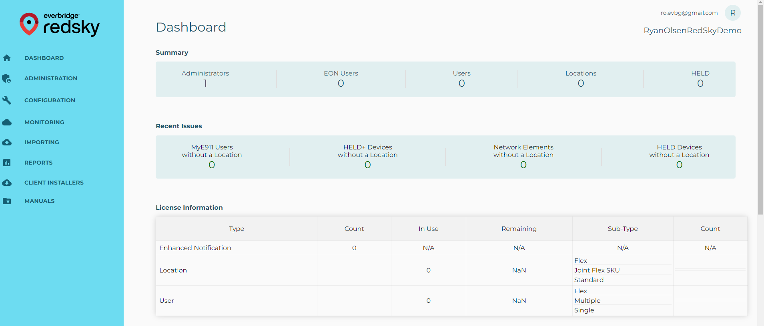
RedSky Dashboard
After logging in you will reach the RedSky Dashboard.

Slide 8
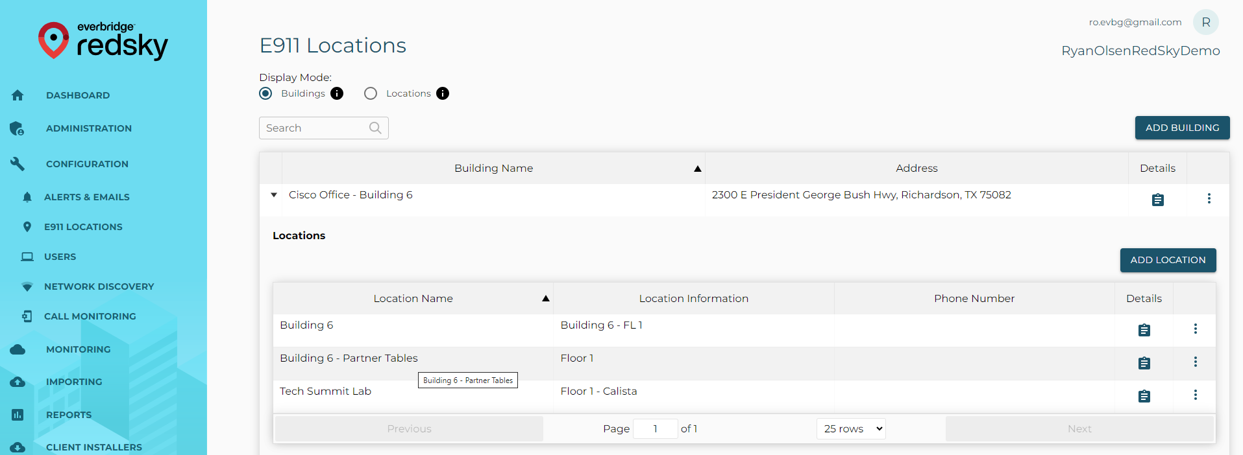
Add Buildings and Locations
Navigate to Configuration > E911 Locations to create Buildings and Locations.

Slide 9
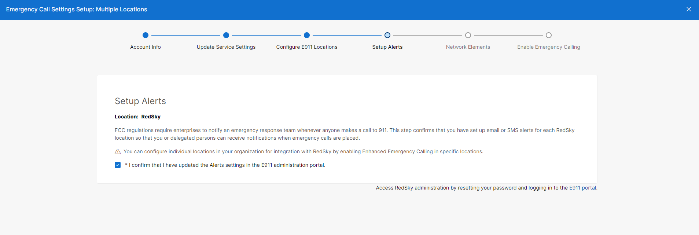
Setup Alerts
Back in Control Hub you can confirm that Locations have been configured. You will then be asked to configure Alerts.

Slide 10
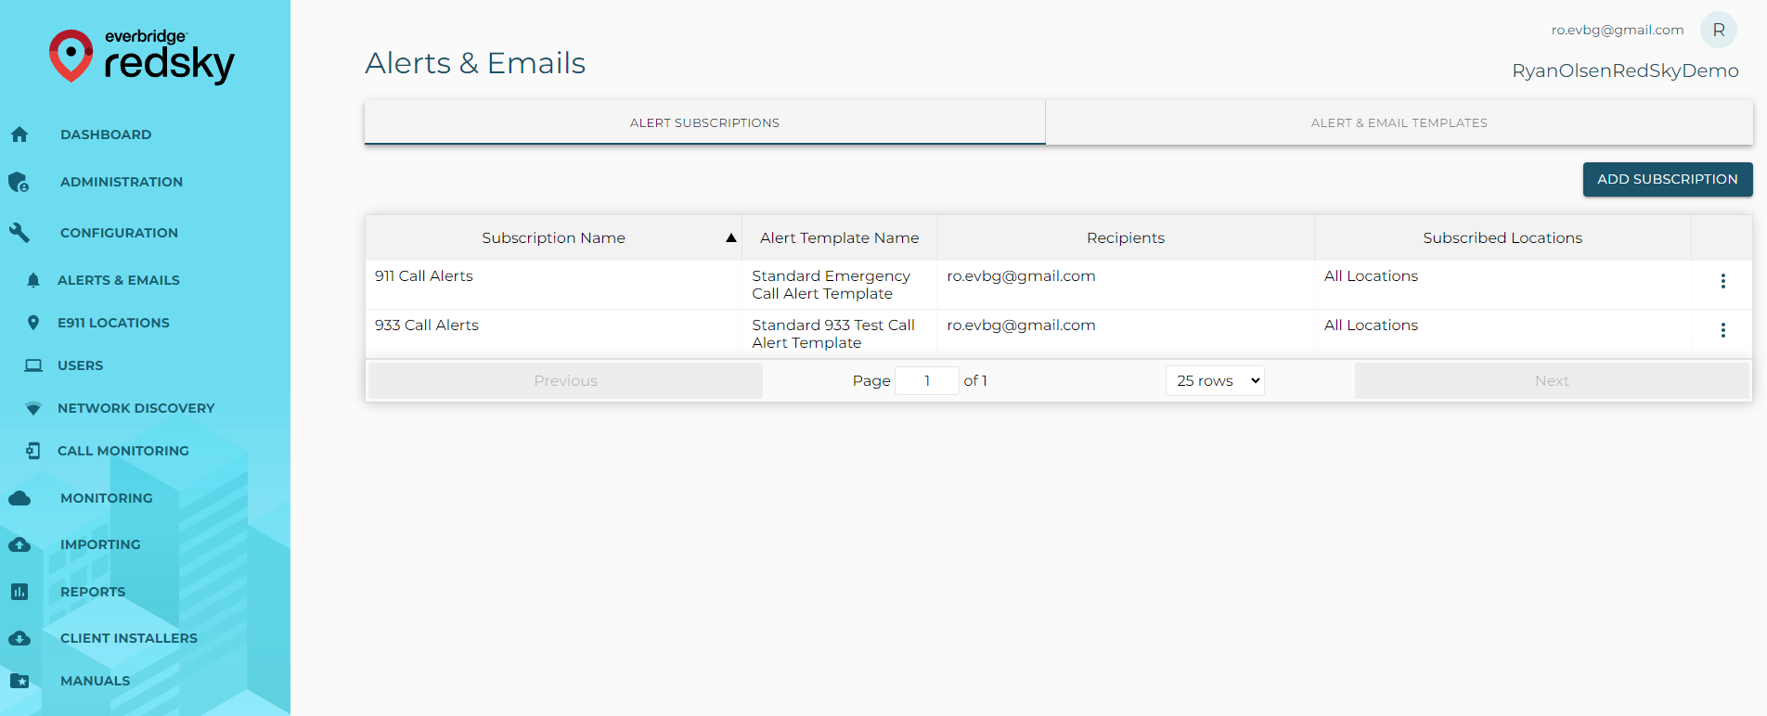
RedSky Alert Configuration
Navigate to Configuration > Alerts & Emails. Create alert subscriptions for 911 and 933 calls.

Slide 11
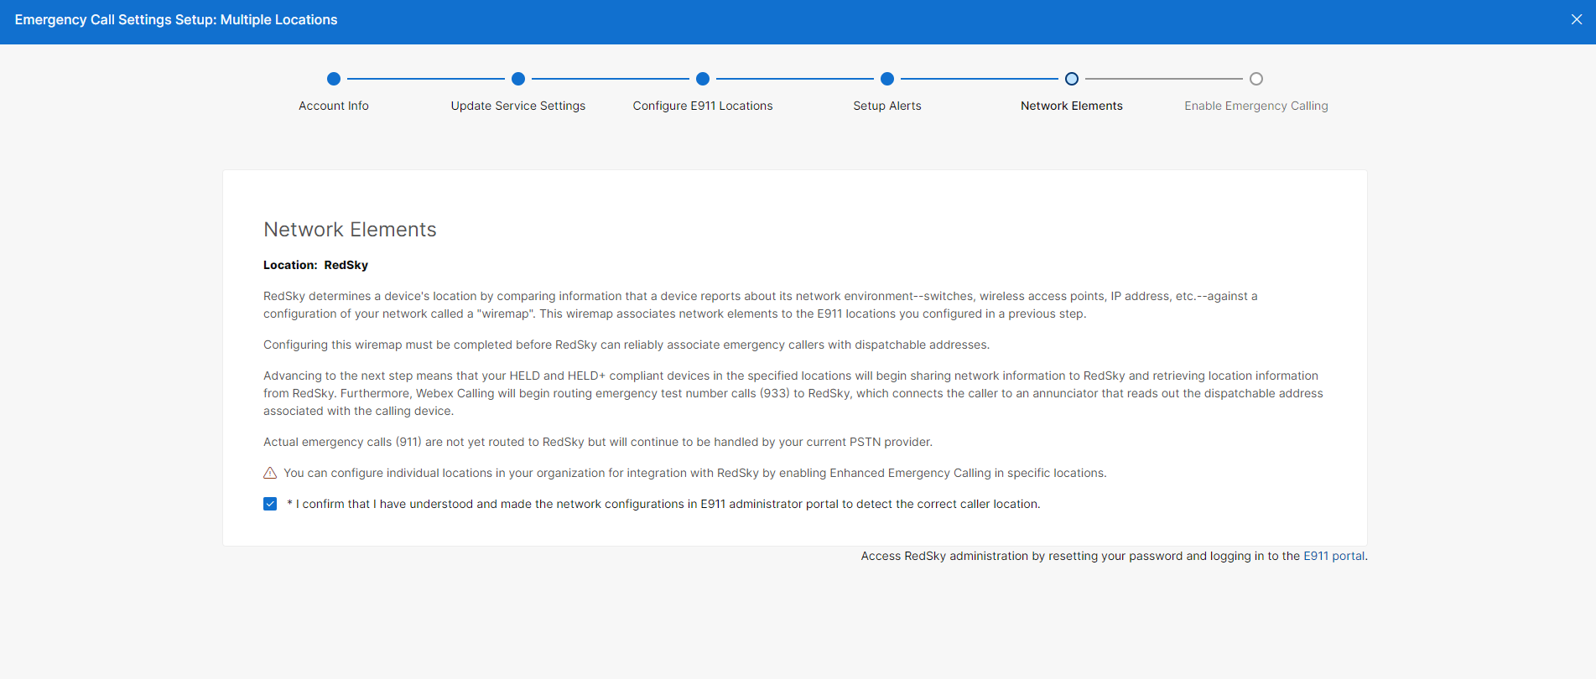
Network Elements
After creating alerts, you will be prompted to create Network Mappings.

Slide 12
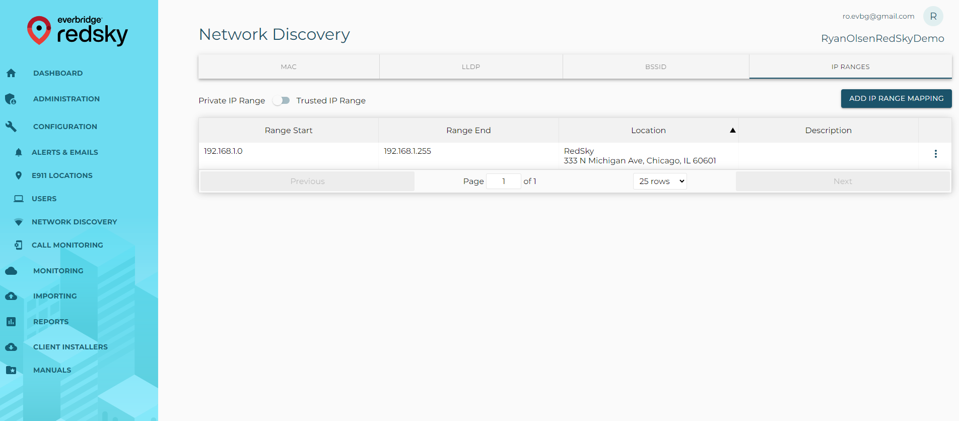
Network Discovery Configuration
Navigate to Configuration > Network Discovery. MAC Address, LLDP, BSSID, and IP Range are all supported. Network elements get mapped to E911 Locations to update the phone’s location automatically.

Slide 13
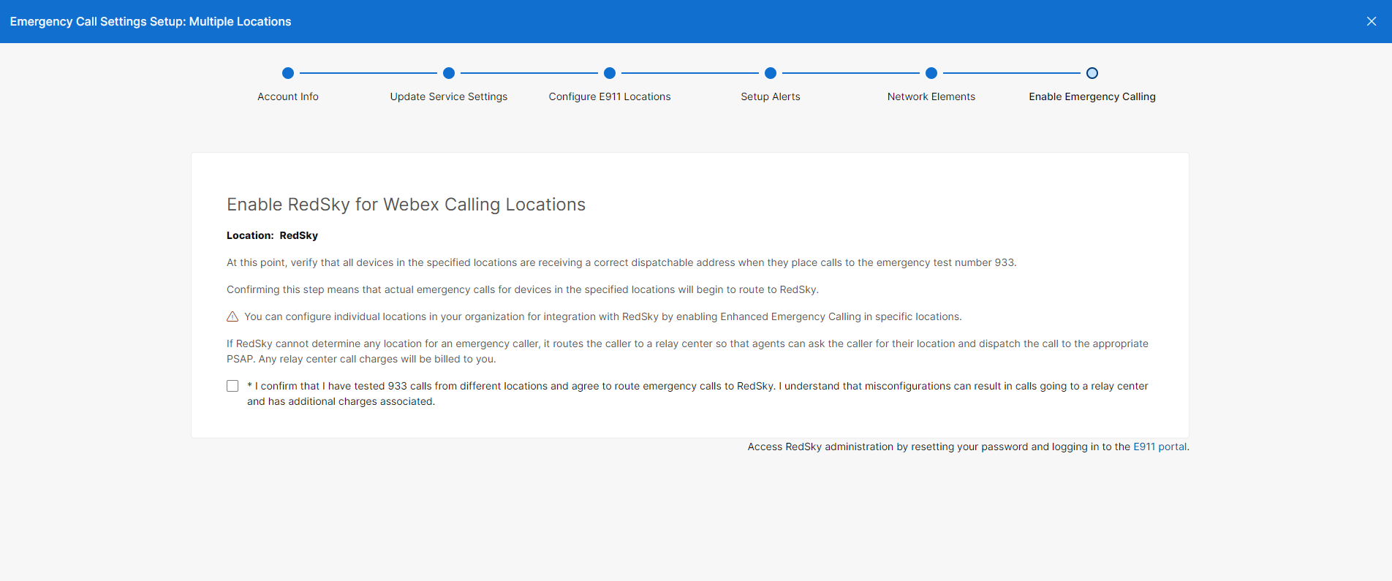
Enable Live 911 Calling
The last step is to Enable Live Calling. Only do this if you want 911 calls to route directly to the PSAP. For testing you can leave this step incomplete. 933 calling will still work for testing.

Slide 14
Confirm Setting in Control Hub

Slide 15
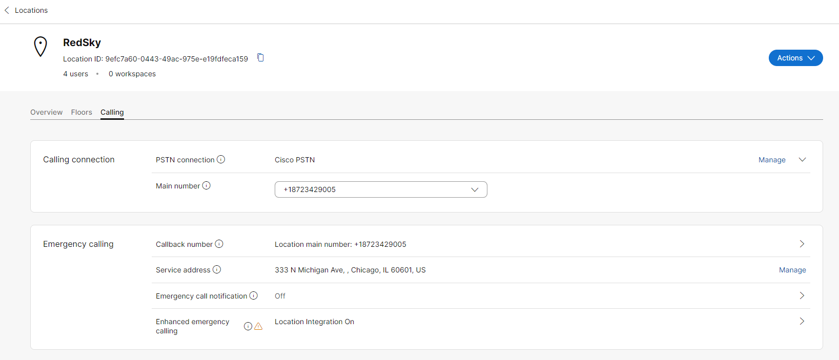
Location Emergency Calling
Location > Calling. Emergency Calling should show Enhanced Emergency Calling on. The Callback number will be used for any users without a DID.

Slide 16
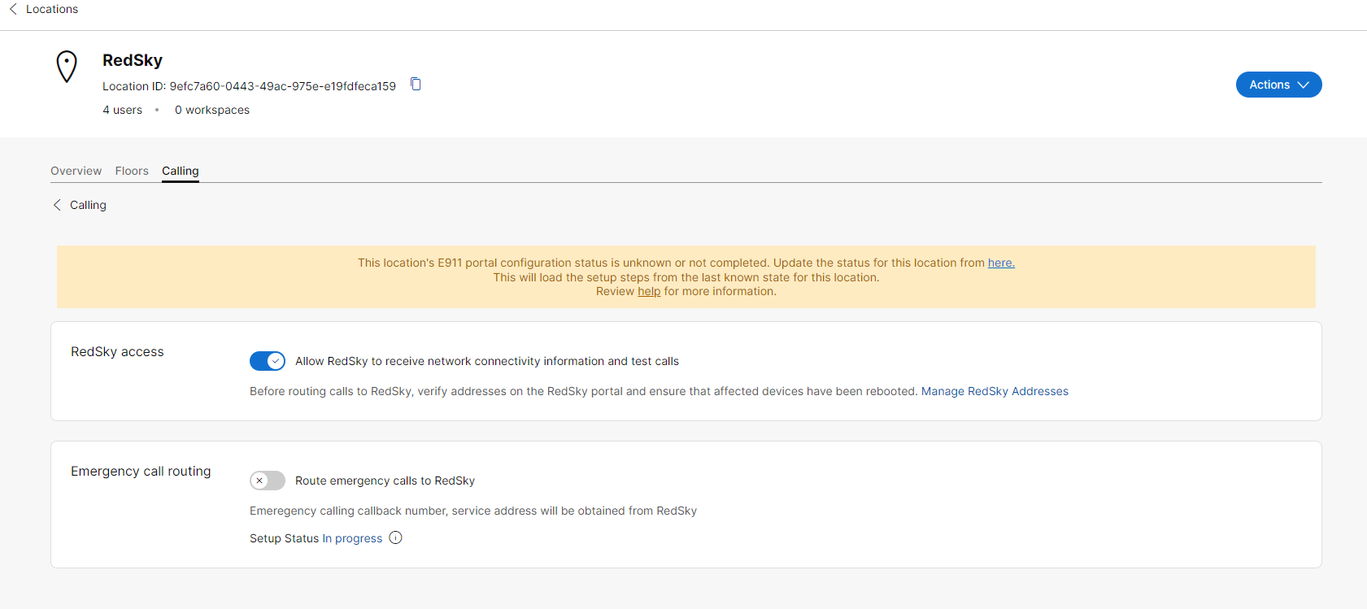
Testing Enabled
This screen confirms the connection to RedSky is active for Network Discovery and 933 calling. Enabling Emergency Call routing will turn on 911 calling also.

Slide 17
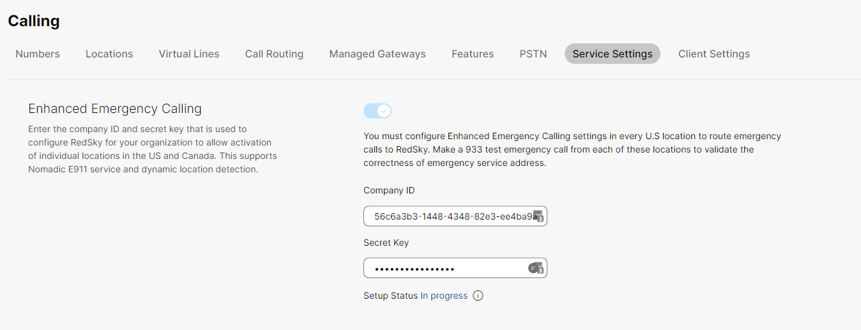
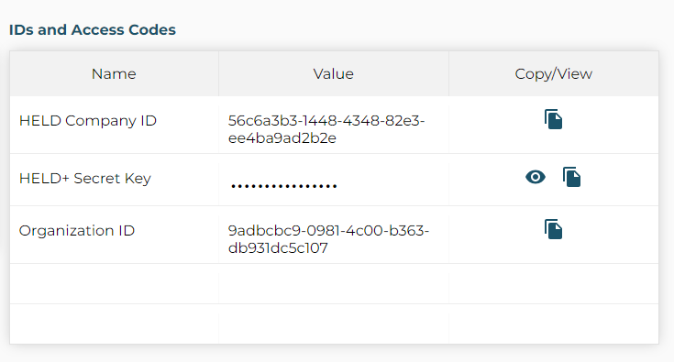
RedSky Company ID and Secret Key
RedSky Company ID and Secret Key will have been automatically added to Control Hub.

Slide 18
Webex App

Slide 19
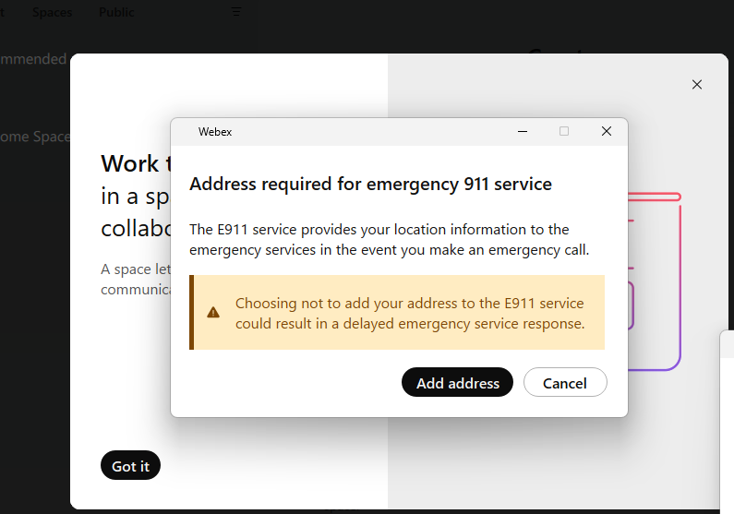
Webex Prompt for Location
If your Webex app is in an unknown location, you will now be prompted to set your emergency address.

Slide 20
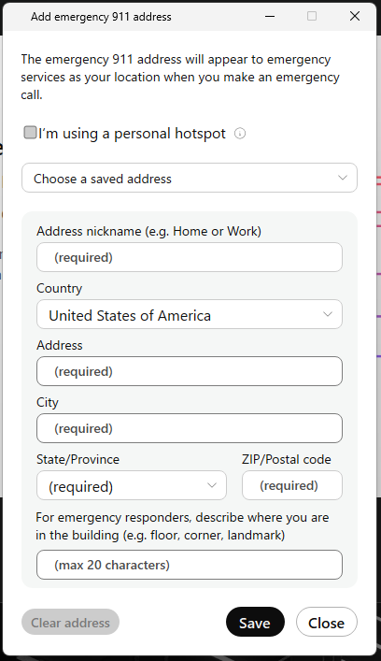
Add Location Screen

Slide 21
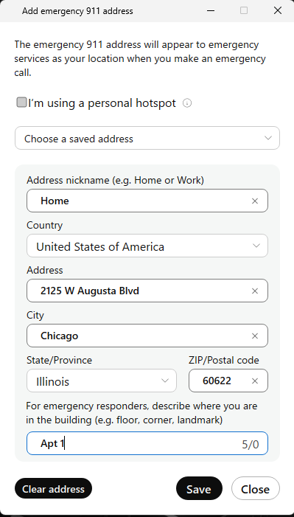
Add Location cont.

Slide 22
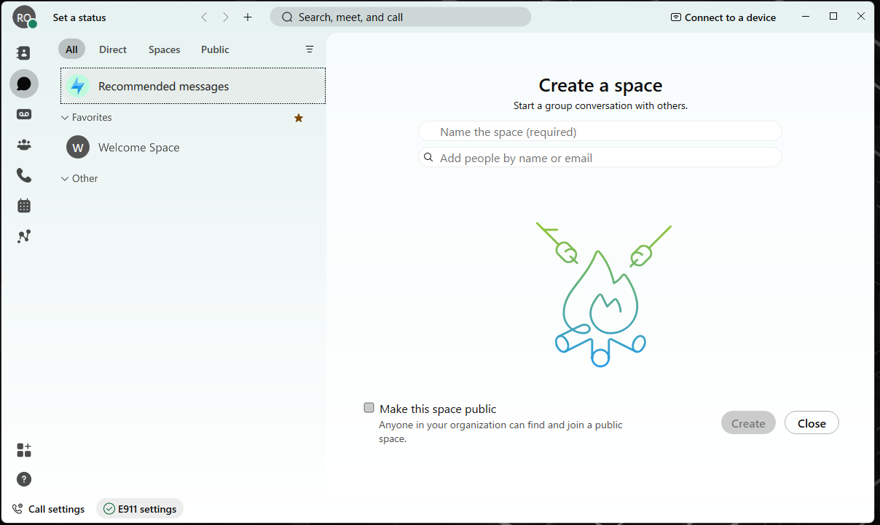
E911 Location Confirmed

Slide 23
Verify RedSky portal

Slide 24
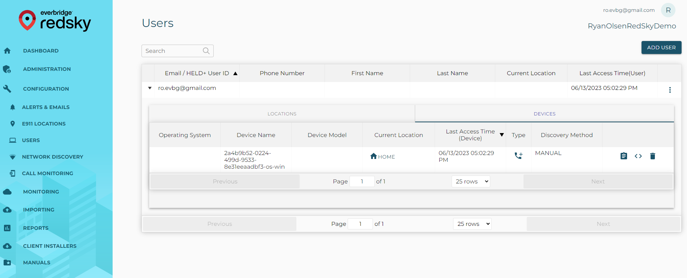
Location Synced to RedSky
Navigate to Configuration > Users to view your Webex user. Expand the user and click the Devices tab to view your location.

Slide 25
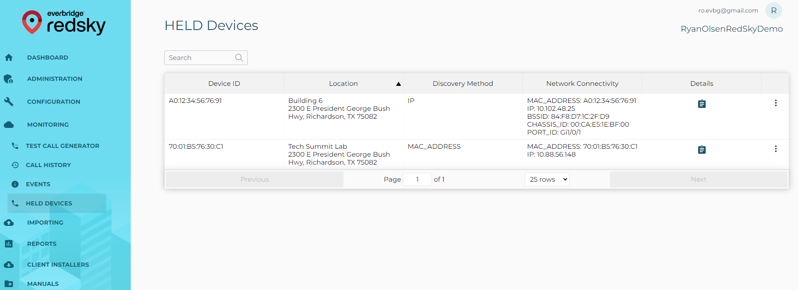
View MPP Phones
MPP Phones will display under Monitoring > HELD Devices. If the phone has a location it will display, and show how it was found (IP, LLDP, BSSID, MAC). If the phone has no location, it will be highlighted in red.

Slide 26
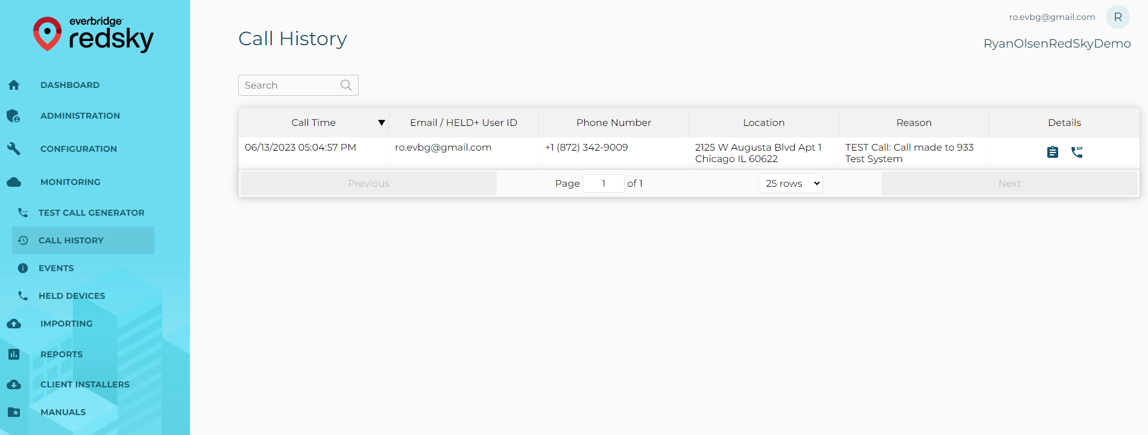
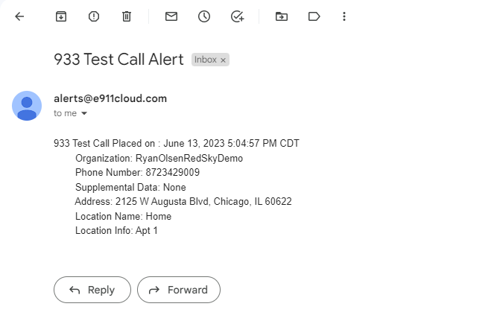
933 Test Call
Place a 933 call. The call should log under Monitoring > Call History. Any 933 alerts you configured should trigger also.

