Slide 1
Wiremap Options

Slide 2
Why the need for a wiremap?
HELD enabled hard phones as well as HELD + Devices (Webex Calling Users) need an emergency location set within RedSky in order to properly reach the correct PSAP with the appropriate location.
The wiremap is determined by how the organizations network is configured today. Use the appropriate network discovery method in order to best break up your buildings into useful locations
A good thought exercise to determine a location is to imagine emergency responders getting to the address listed and needing to get to the caller without any help.
The location information such as “Floor 2 Northwest Corner” is useful but also keep in mind we need to tie a network element to this location.
Network Elements available:
MAC Address
LLDP Chassis (can also map down to the port level)
BSSID (routers/access points)(BSSID is NOT the SSID)
IP Range
Webex Calling remote users will also have their locations automatically set to a location when coming into the office as opposed to being prompted by Webex to enter an emergency location.

Slide 3
Emergency Response Locations
Useful Links:
https://www.redskye911.com/e911-compliance
https://www.fcc.gov/mlts-911-requirements
There are 4 primary pieces of information sent to the PSAP:
Building Address (Building Name is NOT sent)
Location Information (Location Name is NOT sent)
Company Name (Can be overridden on building or location level)
Phone Number (This is set on Control Hub as the ECBN)
Location Information is used to create a dispatchable location for a specific floor, area, room inside of the building.
The Location Information field is 60 characters. Each PSAP is different so their display may not show the full information listed which is why a LIVE test may be necessary.

Slide 4
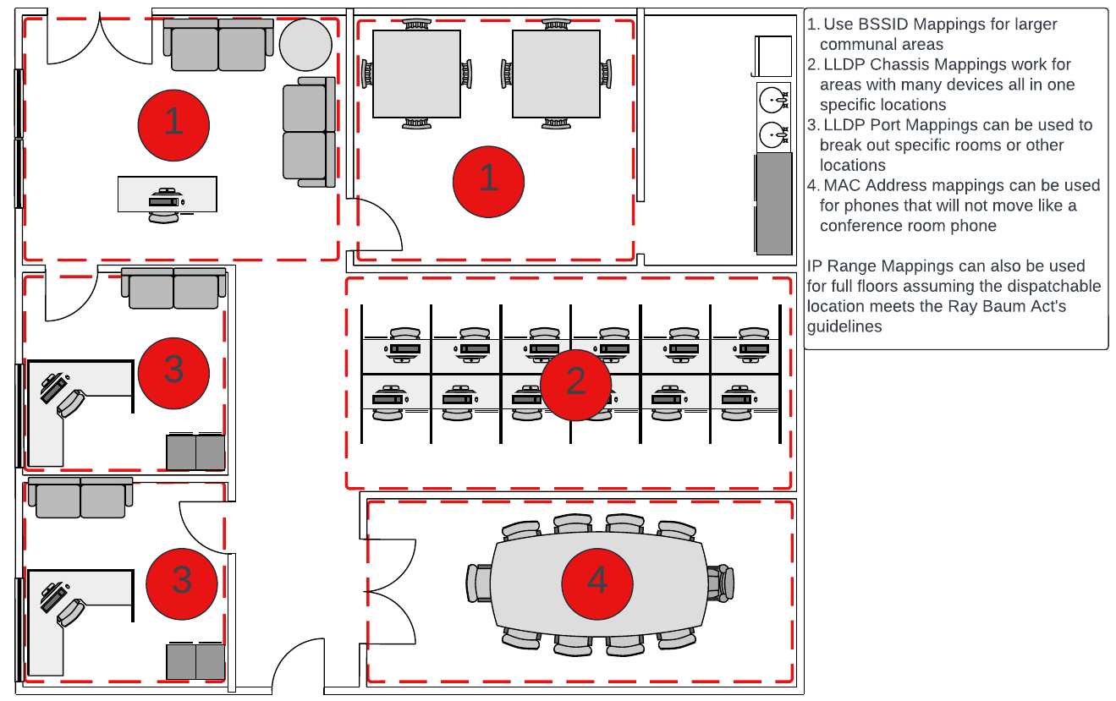
Wiremap Example

Slide 5
Importing Wiremap
On the left panel you will find a section called “Importing”
The Template Files button will expand a dropdown of the various templates include the Sample and Reference file
Sample and Reference is a great example of the formatting for each out the fields
Each file will need to be imported separately starting with Buildings and Locations and followed by network elements

Slide 6
Network Discovery Priority
Horizon Mobility® supports a hybrid technique of Network Discovery. This means that a customer has the ability to “mix and match” the network discovery method that best suits their requirements. However, the customer should be conscious of the order of operation. The prioritized order of Network Discovery is as follows:
*IP Range mapping should only be used for corporate locations and requires the whitelisting of the corporate network public IP addresses.
MyE911:
LLDP Port Personal Mapping
LLDP Port Corporate Mapping
LLDP Chassis Corporate Mapping
BSSID Personal Mapping
BSSID Corporate Mapping
Layer 3 IP Range*
Default Gateway MAC Address
HELD:
MAC Address
LLDP Port Mapping
LLDP Chassis Mapping
BSSID Corporate Mapping
Layer 3 IP Range*
HELD+ (Check with your vendor to confirm your client supports LLDP discovery):
LLDP Port Personal Mapping
LLDP Port Corporate Mapping
LLDP Chassis Corporate Mapping
BSSID Personal Mapping
BSSID Corporate Mapping
Layer 3 IP Range*
Default Gateway MAC Address

Slide 7
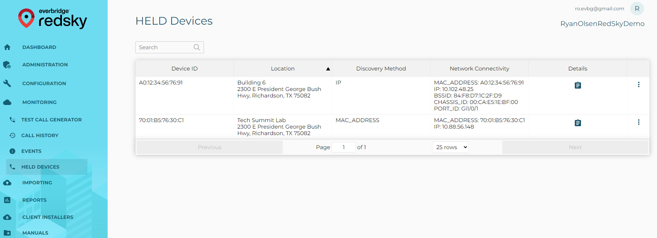
Location Confirmation
When you select the HELD DEVICES you will see a list of the devices and their Discovery Method
Note: Cisco devices may take up to 24 hours to re-register or you can reboot the phone to test

Slide 8
Testing
933 is used as the testing system and will stop at RedSky where you will an IVR read back the phones location
These calls will also show up in the Monitoring > Call History section as well as you can setup email or text message alerts for 933 calls
Testing should be done from a variety of HELD Devices as well as remote and in office Webex calling HELD + Users

