Slide 1
Cisco Call with MS Teams

Slide 2
Prerequisites
User created in MS Teams and Control Hub using the same email address
  There are extra steps when integrating with CUCM:
    https://help.webex.com/en-us/article/n0l9q2z/Configure-Cisco-Call-for-Microsoft-Teams
Cisco Call is added as a Teams app
Must be logged into the Webex app to use the calling features

Slide 3
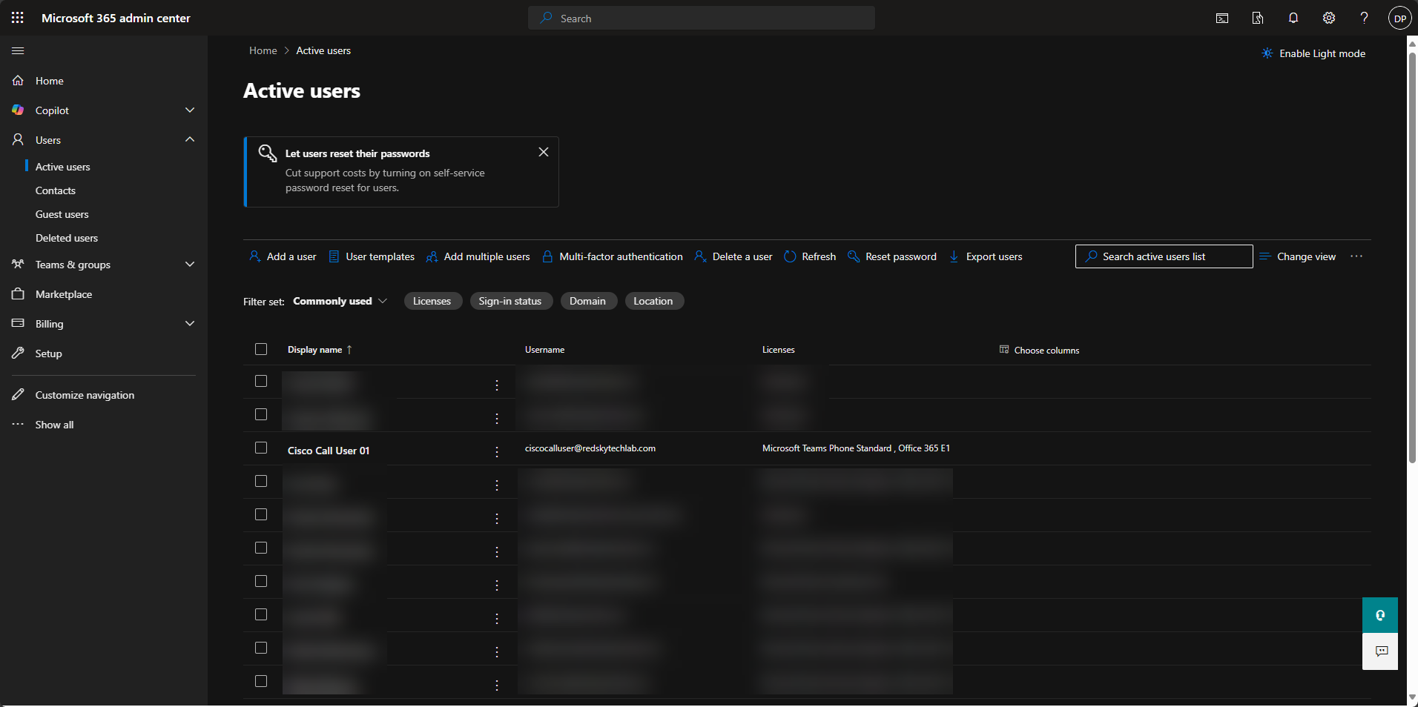
User Configuration in MS Teams

Slide 4
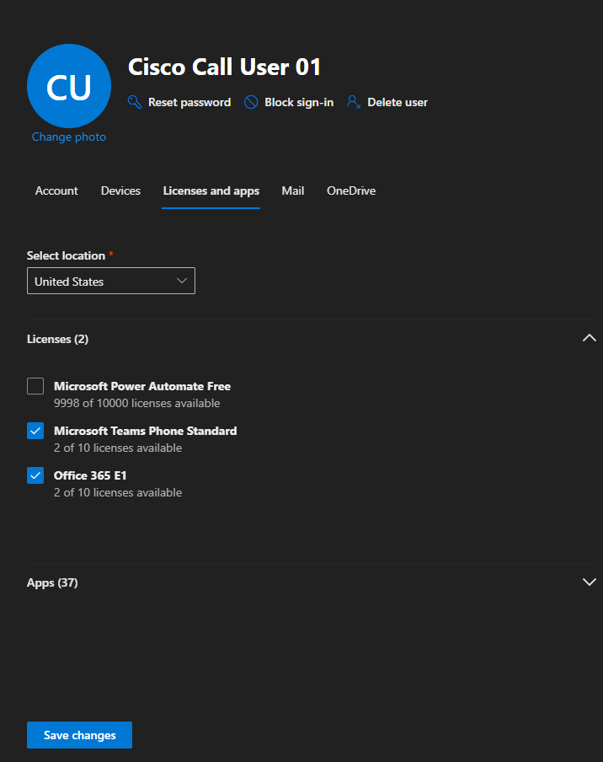
User Configuration in MS Teams (Licenses)
Need to assign Microsoft Teams Phone Standard and Office 365 licenses
The minimum Office 365 licenses needed are:
  Microsoft Teams
  Exchange Online
  Office for the web
    To receive activation emails from Control Hub

Slide 5
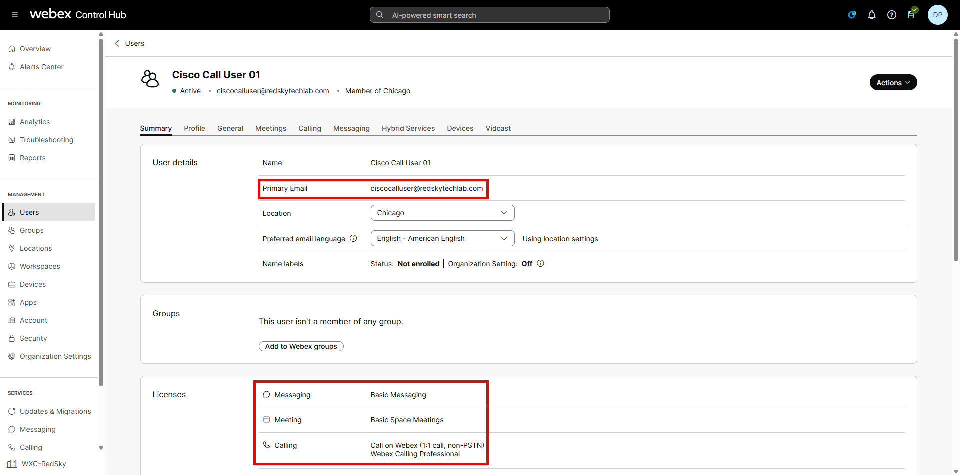
User Configuration in Control Hub

Slide 6
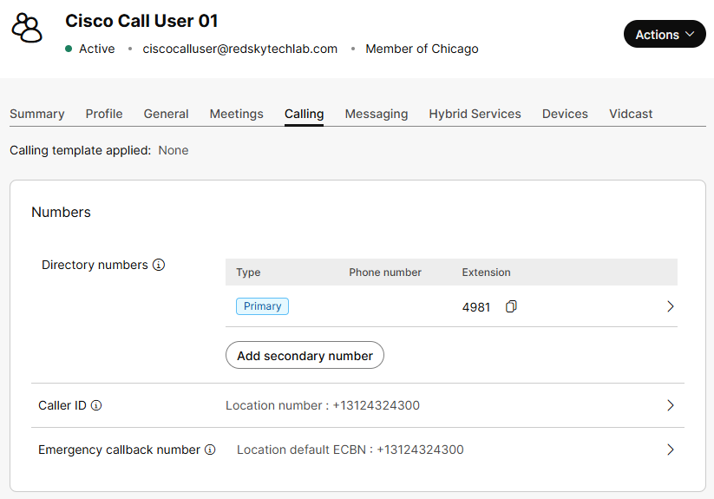
User Configuration in Control Hub (Calling)
Assign phone number/extension to user in Control hub

Slide 7
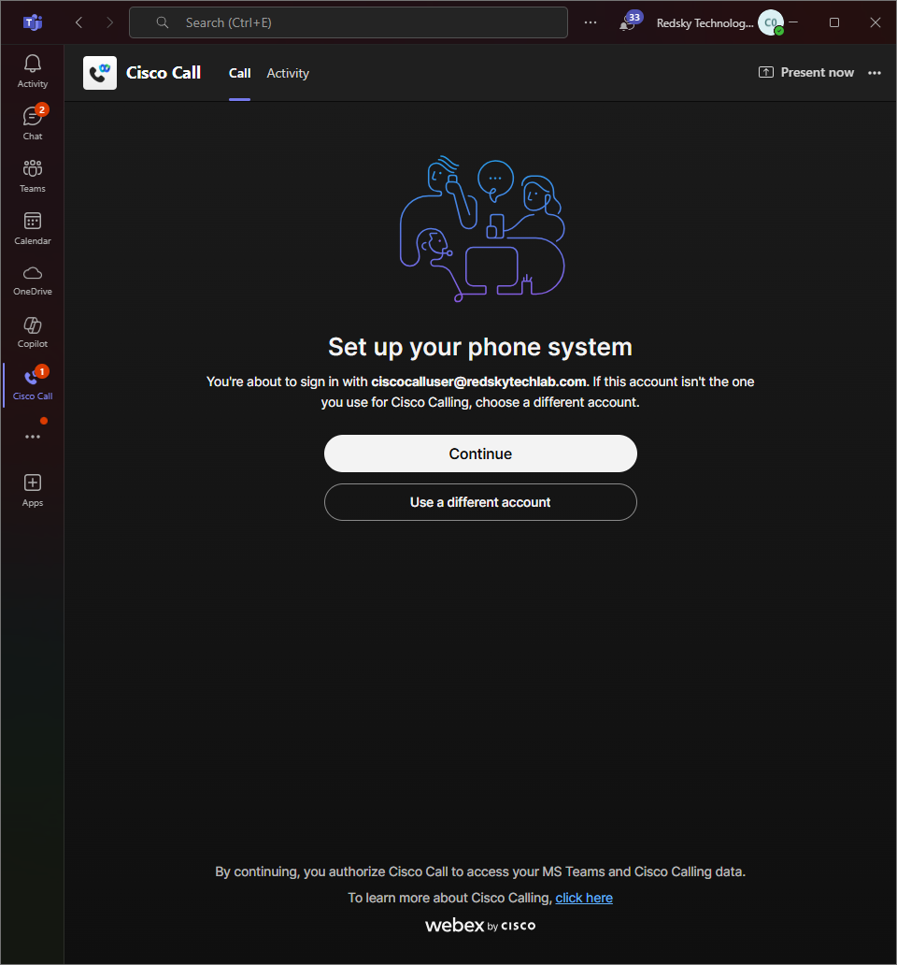
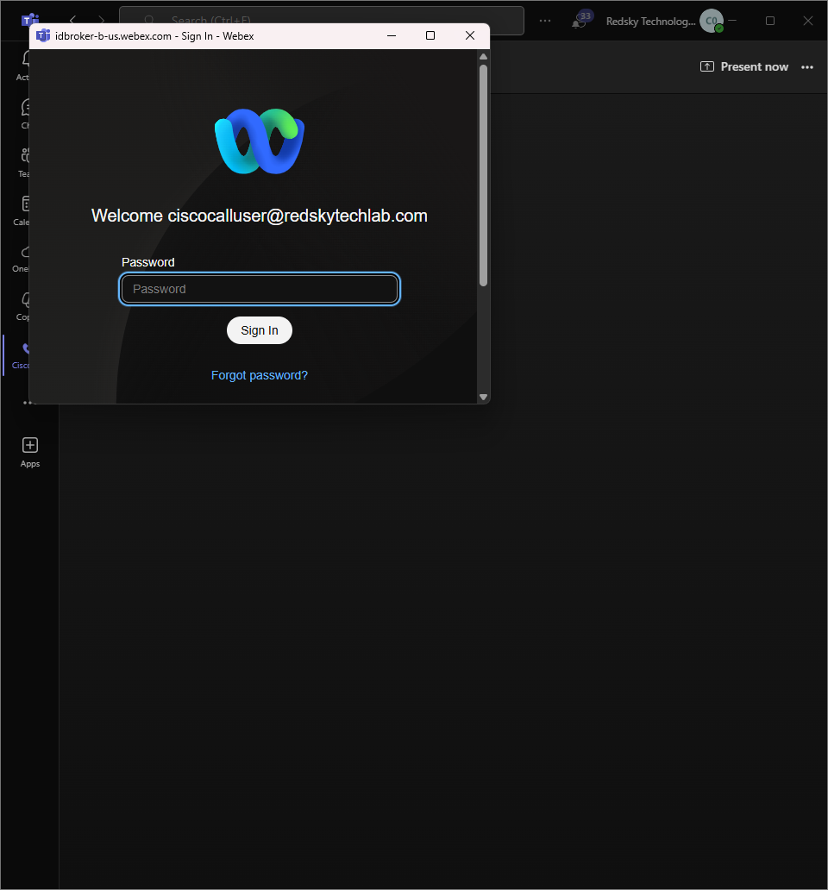
Initial Setup for Cisco Call in MS Teams
Authenticating Webex App

Slide 8
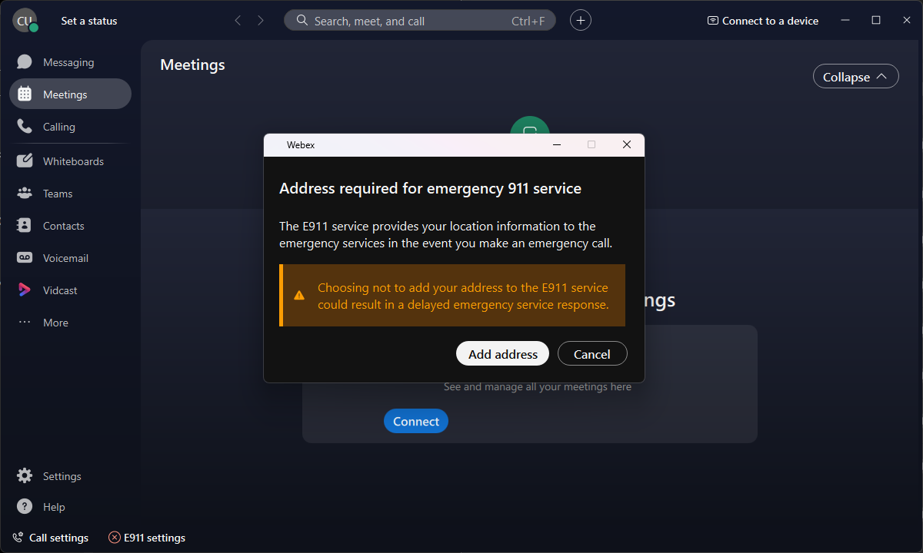
Webex Popup for Unknown Location

Slide 9
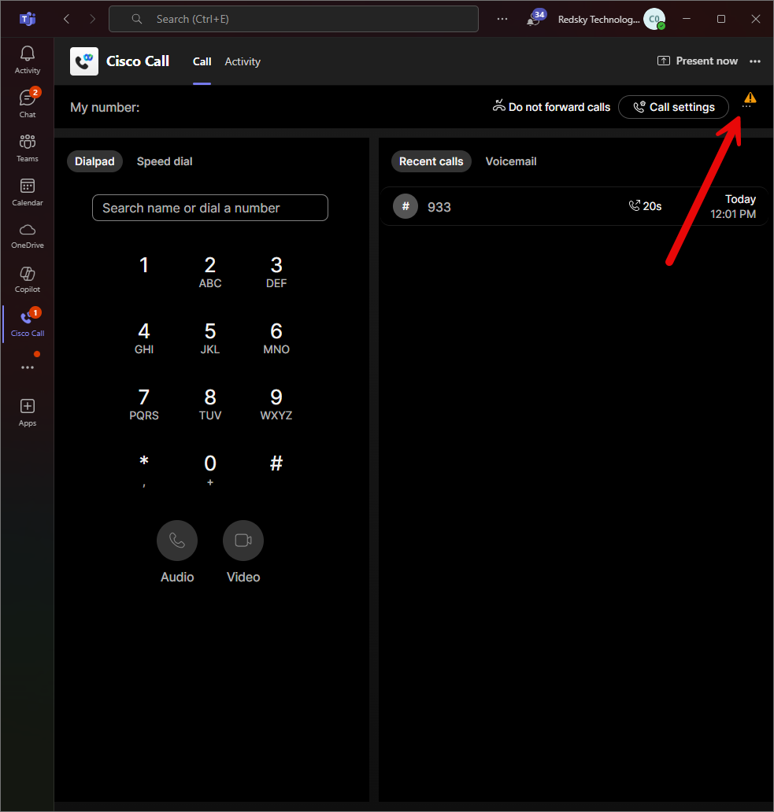
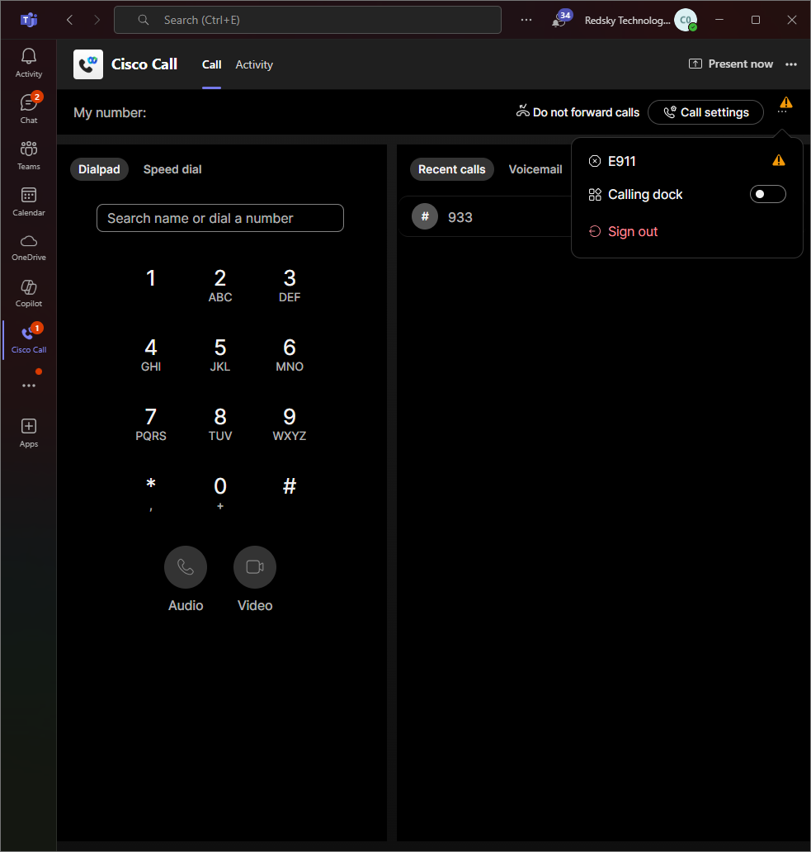
MS Teams with Unknown E911 Location

Slide 10
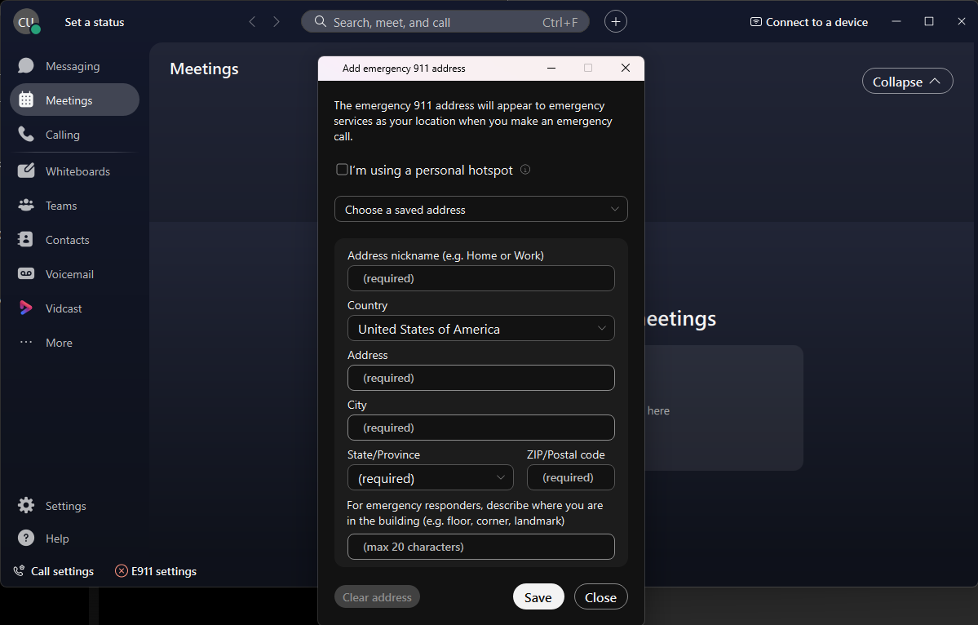
Entering Location Data in Webex App
Clicking E911 in MS Teams opens up E911 settings in Webex app

Slide 11
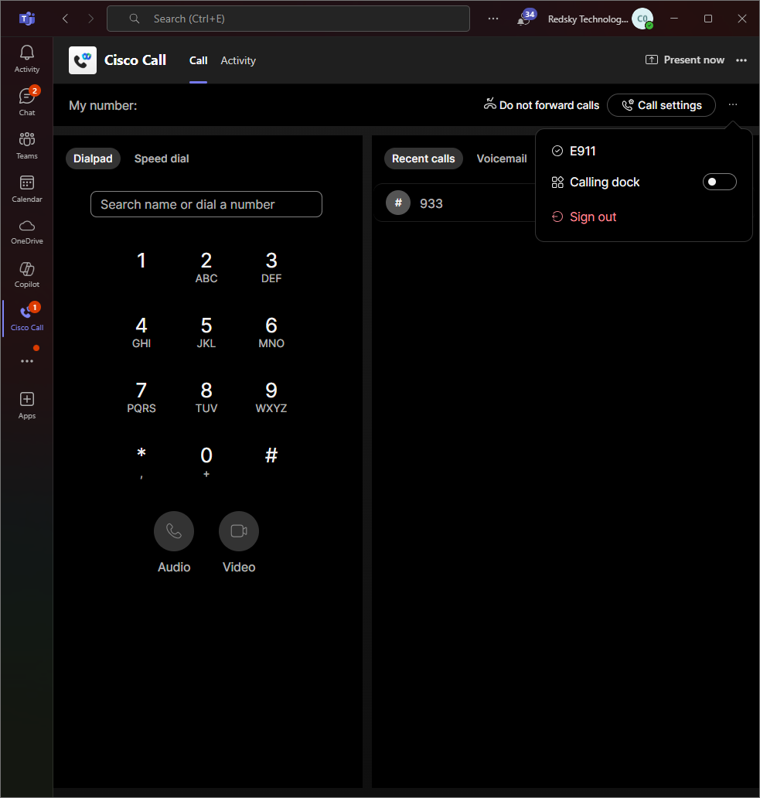
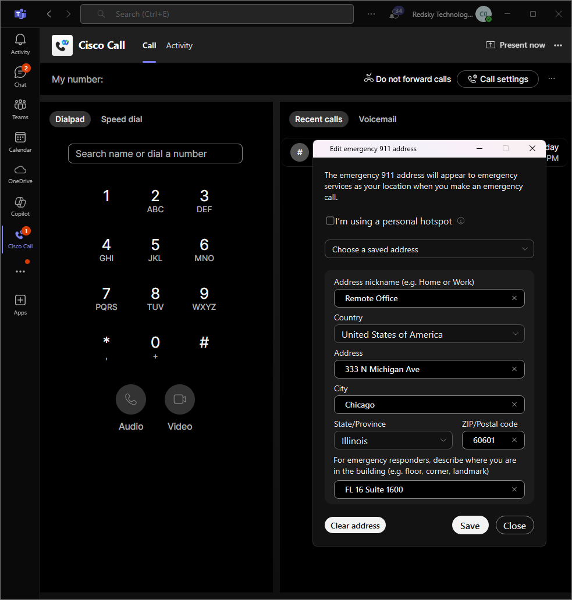
E911 Location Set in MS Teams
No warning when E911 Location is set
Clicking ‘E911’ shows current location in Webex app

